Slide 1


Population, Ethnicity and Educational attainment analysis, 1950-2010 BOSTON
Spatial Data Studio
Final project
Rachid Berghout

Slide 2
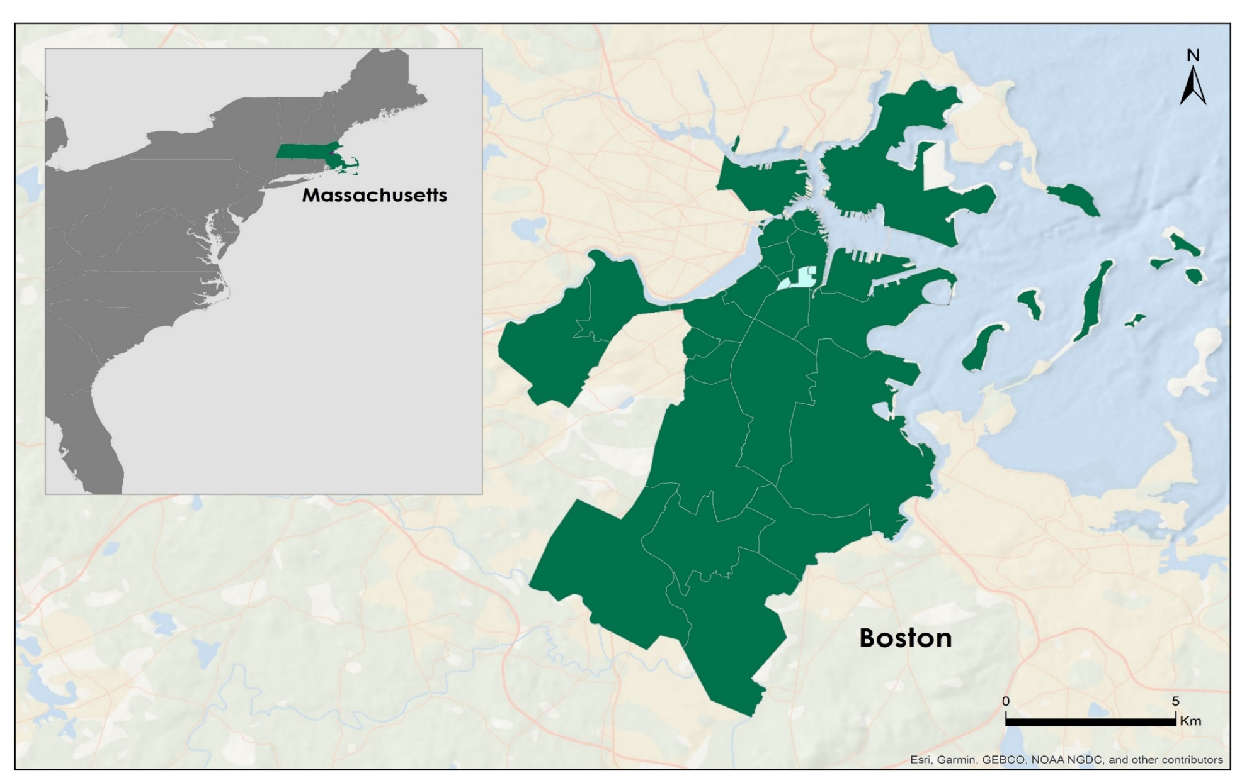
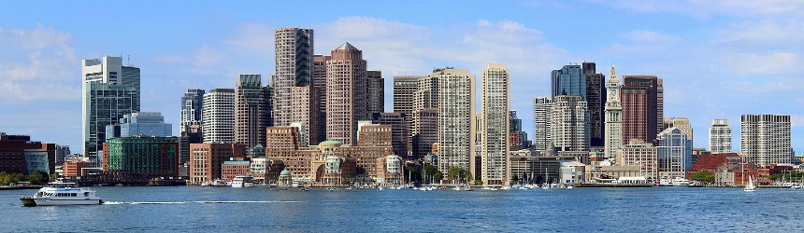

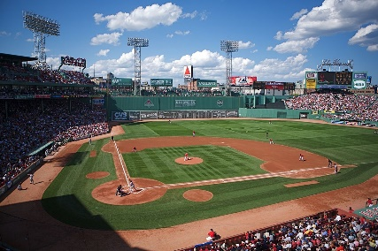
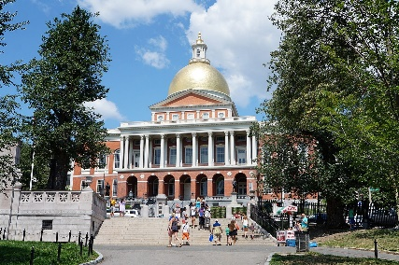
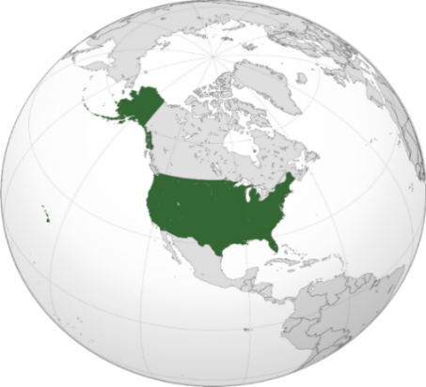
The purpose of this project is to analyze how population, educational attainment and ethnicity have changed over time (1950-2010) and in relation to each other in Boston.
BOSTON
Geographical location of Boston city
B
Rachid Berghout
Clockwise from top: Downtown; Massachusetts State House; Back Bay and the Charles River; Fenway Park.
Source: Wikipedia
B

Slide 3
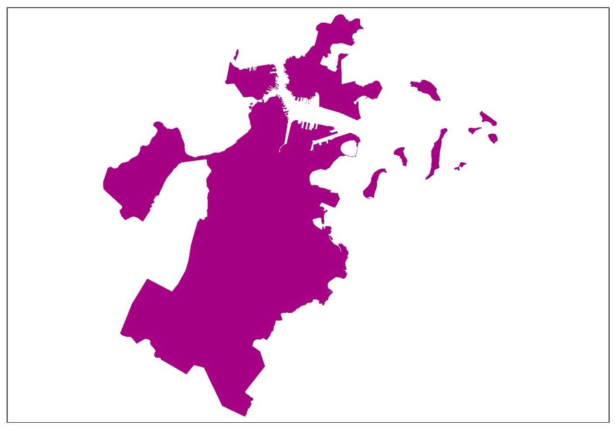
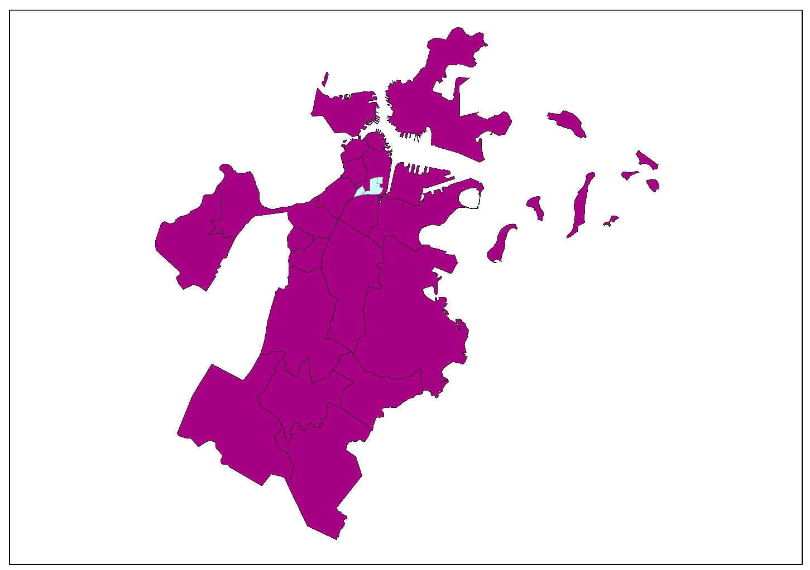





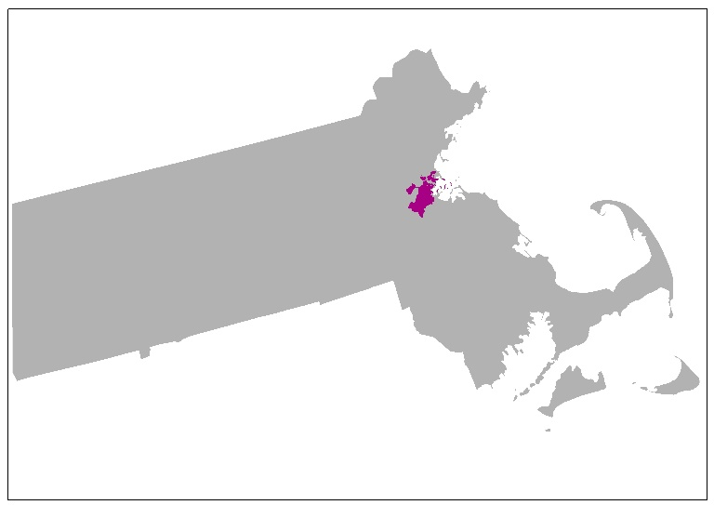
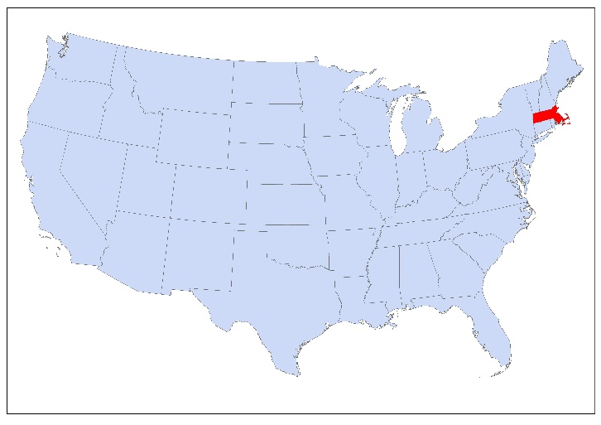


Boston
Basic Information
State: Massachusetts
Area: 232,14 km2
Population: 685 094
Density: 5463/km2
foundation: 7th September 1630
*2017 estimate
Source: Wikipedia
Massachusetts

Slide 4



Data
Demographic Data for Boston’s Neighborhoods, 1950-2010, taken from ANALYZE BOSTON: the City of Boston's open data hub (https://data.boston.gov/).
Boston Neighborhoods
Educational Attainment (Age 25+)
Race and or ethnicity demographics by neighborhood.
Nativity demographics by neighborhood.
A summary level resource for the Boston Neighborhood Demographics data set.

Slide 5
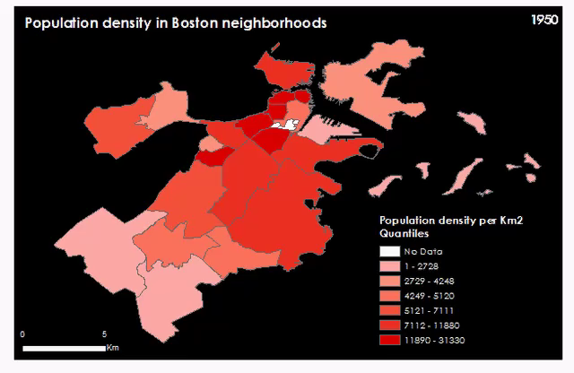
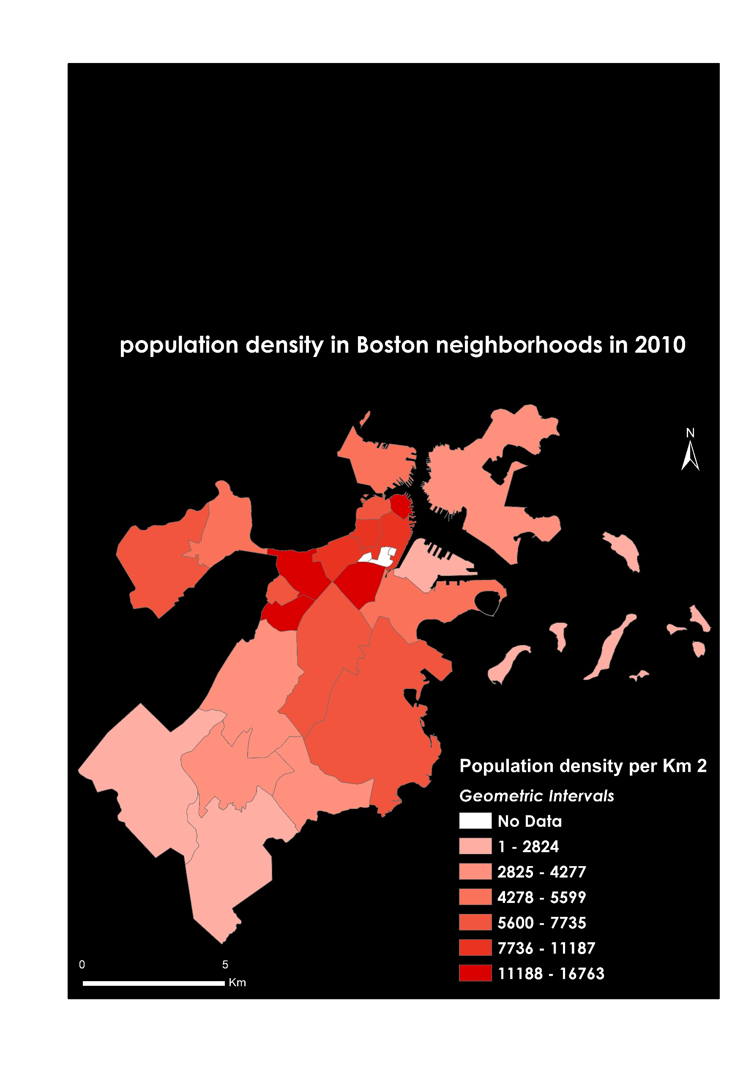
Population density in Boston neighborhoods
Population change
2010
801 444
685 094
617 594
1950
2010
2017
Rachid Berghout
Notes:
NB: There is Population density in Boston neighborhoods 2010 map under the visualisation video

Slide 6
2017
Notes:
NB : The red frames are just for the animation (to Explain each graph separately), not originally existing in the slide.

Slide 7
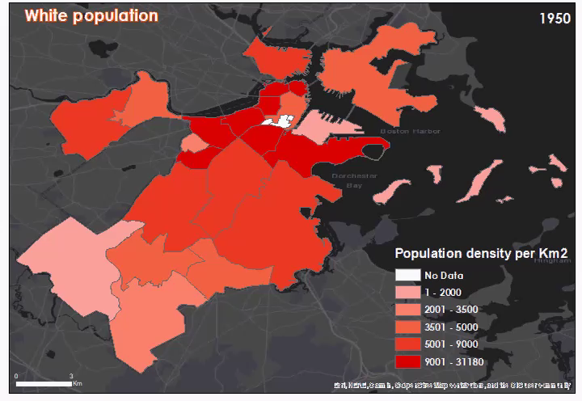


1950
94.67%
758700
1960
90.17%
622745
1970
79.72%
511055
1980
67.83%
381058
1990
53.25%
304416
2000
49.49%
291561
2010
47.01%
290312

Slide 8
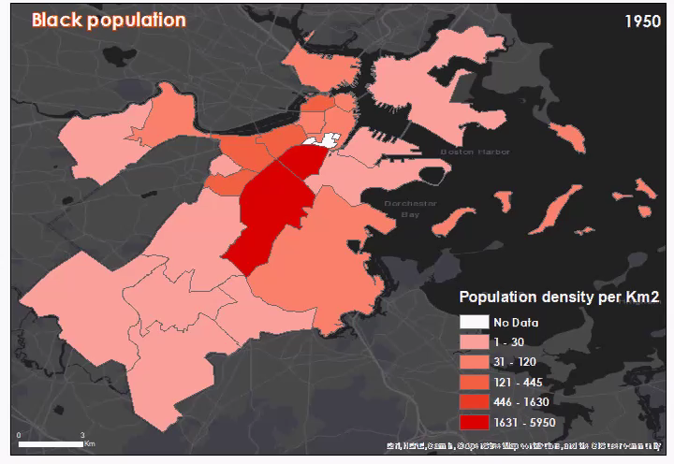
1950
5.00%
40057
1960
9.07%
62665
1970
15.85%
101585
1980
21.74%
122101
1990
19.33%
110492
2000
140305
23.82%
2010
22.36%
138073

Slide 9
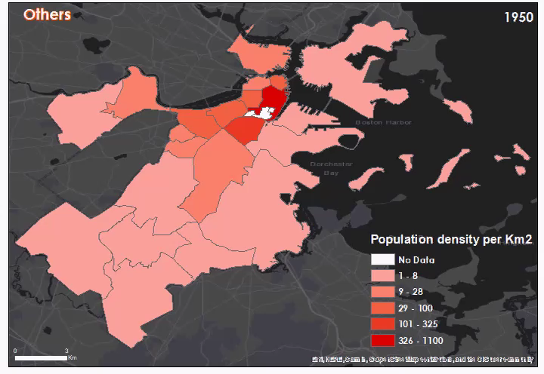
1950
0.34%
2687
1960
0.75%
5207
1970
0.46%
2974
1980
1.36%
7667
1990
13.36%
76398
2000
27906
4.74%
2010
4.25%
26264

Slide 10
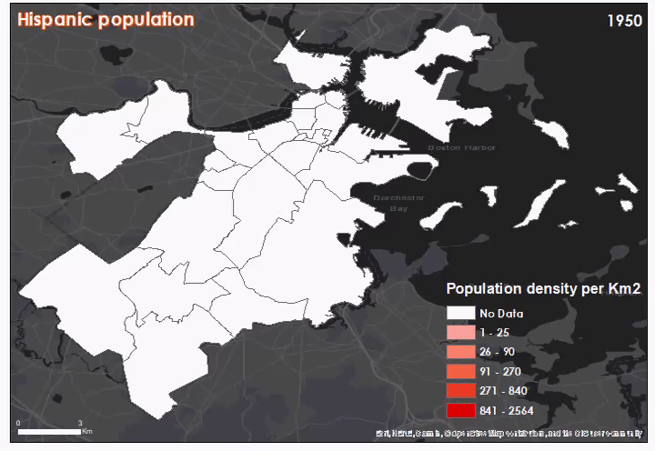
1970
2.65%
19987
1980
6.41%
36032
1990
9.74%
54158
2000
14.44%
85089
2010
17.47%
107917

Slide 11
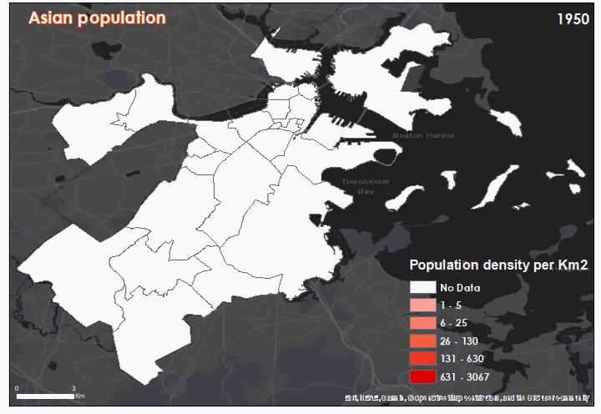
1970
1.32%
8443
1980
2.65%
14898
1990
4.59%
26234
2000
7.52%
44280
2010
8.91%
55028

Slide 12
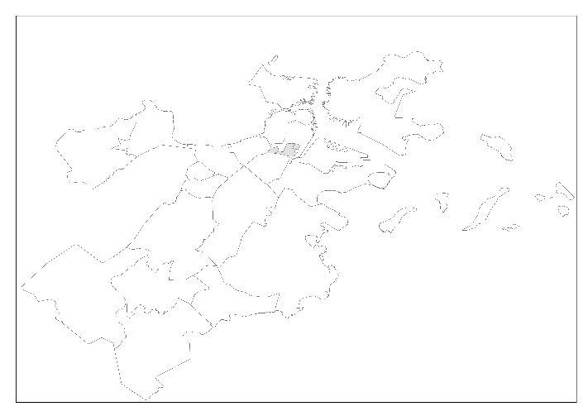
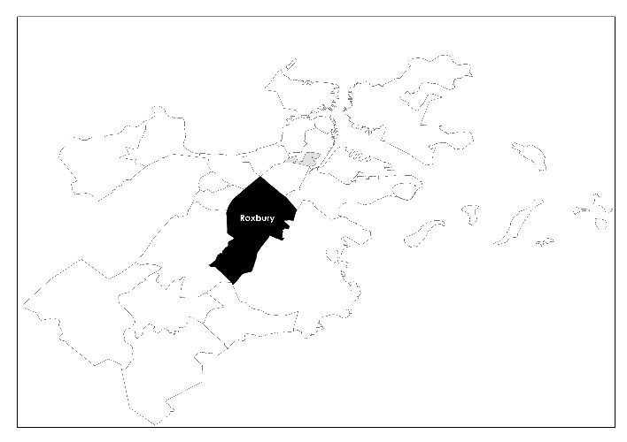
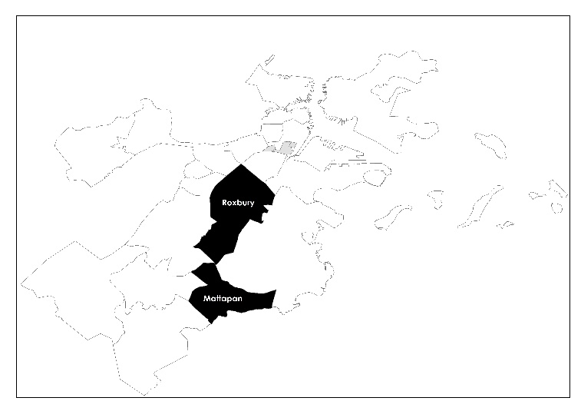

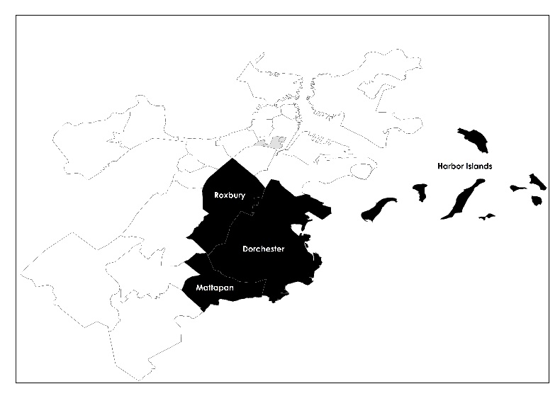
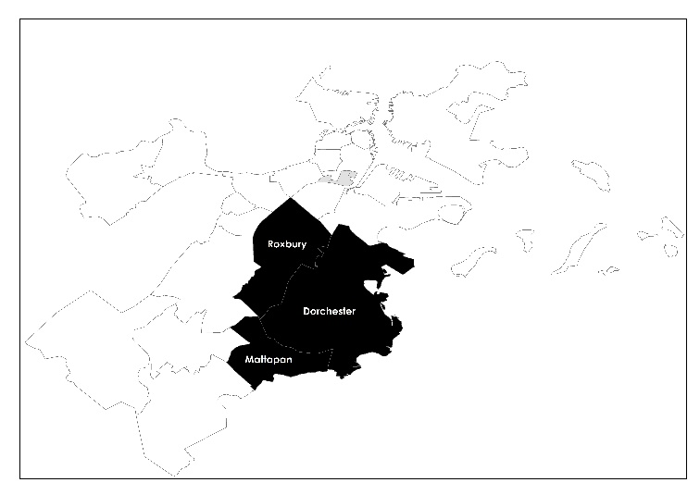
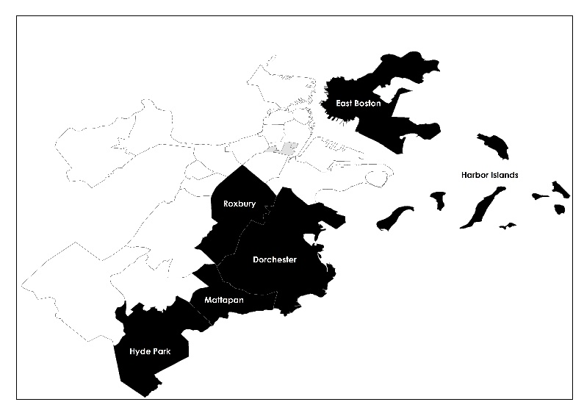
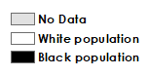
Most Common Ethnicities In Boston Neighborhoods 1950-2010
1950
1960
1970
1980
1990
2000
2010

Slide 13
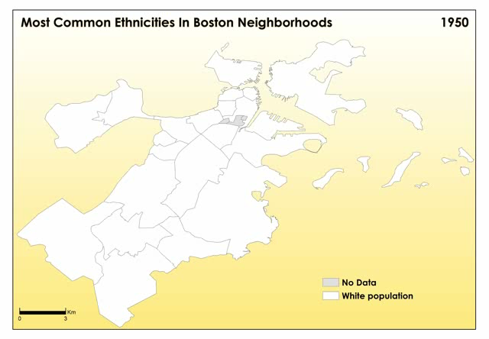

Slide 14
Foreign-born population
1950 1960 1970 1980 1990 2000

Slide 16
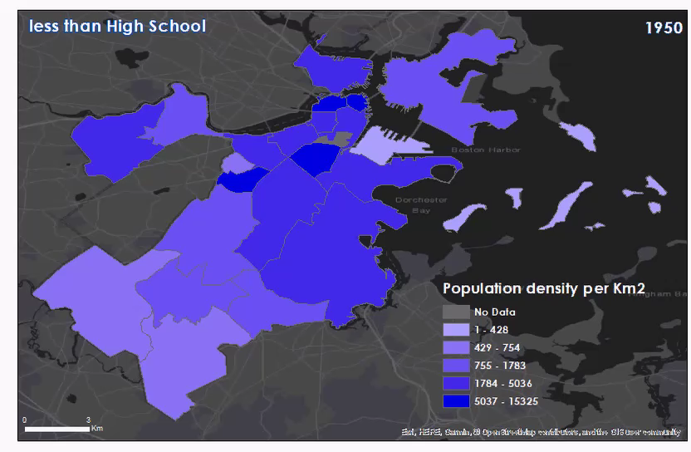
1950
56.25%
269560
1960
55.40%
232490
1970
46.52%
163093
1980
31.57%
104259
1990
24.32%
88857
2000
21.09%
79629

Slide 17
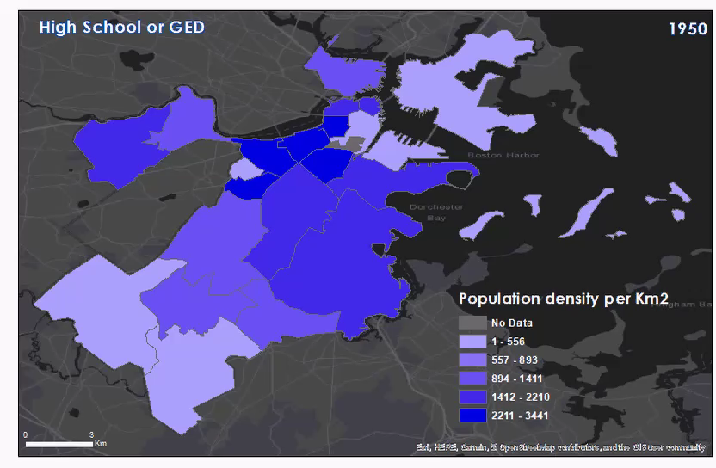
1950
30.16%
144540
1960
29.31%
122983
1970
34.33%
120350
1980
35.00%
115594
1990
26.58%
97105
2000
23.99%
90568

Slide 18
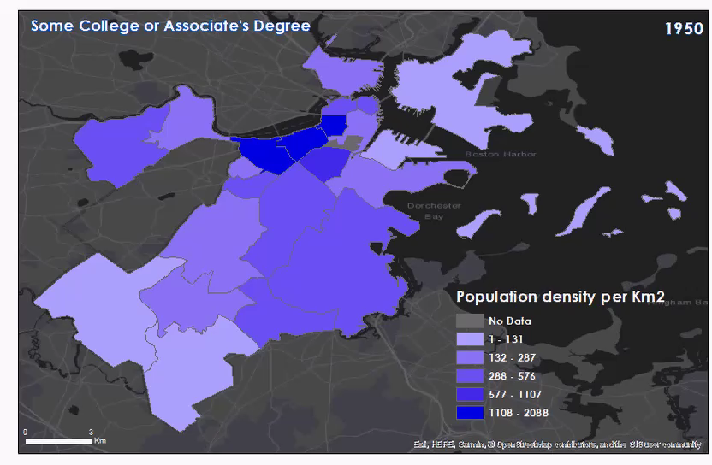
1950
6.88%
32970
1960
7.66%
32159
1970
8.81%
30876
1980
13.13%
43372
1990
19.08%
69718
2000
19.37%
73125

Slide 19
1950
6.71%
32135
1960
7.63%
32001
1970
10.34%
36245
1980
20.29%
67003
1990
30.02%
109675
2000
35.56%
134252

Slide 20
1950
1970
2000
1960
1990
1980

Slide 21
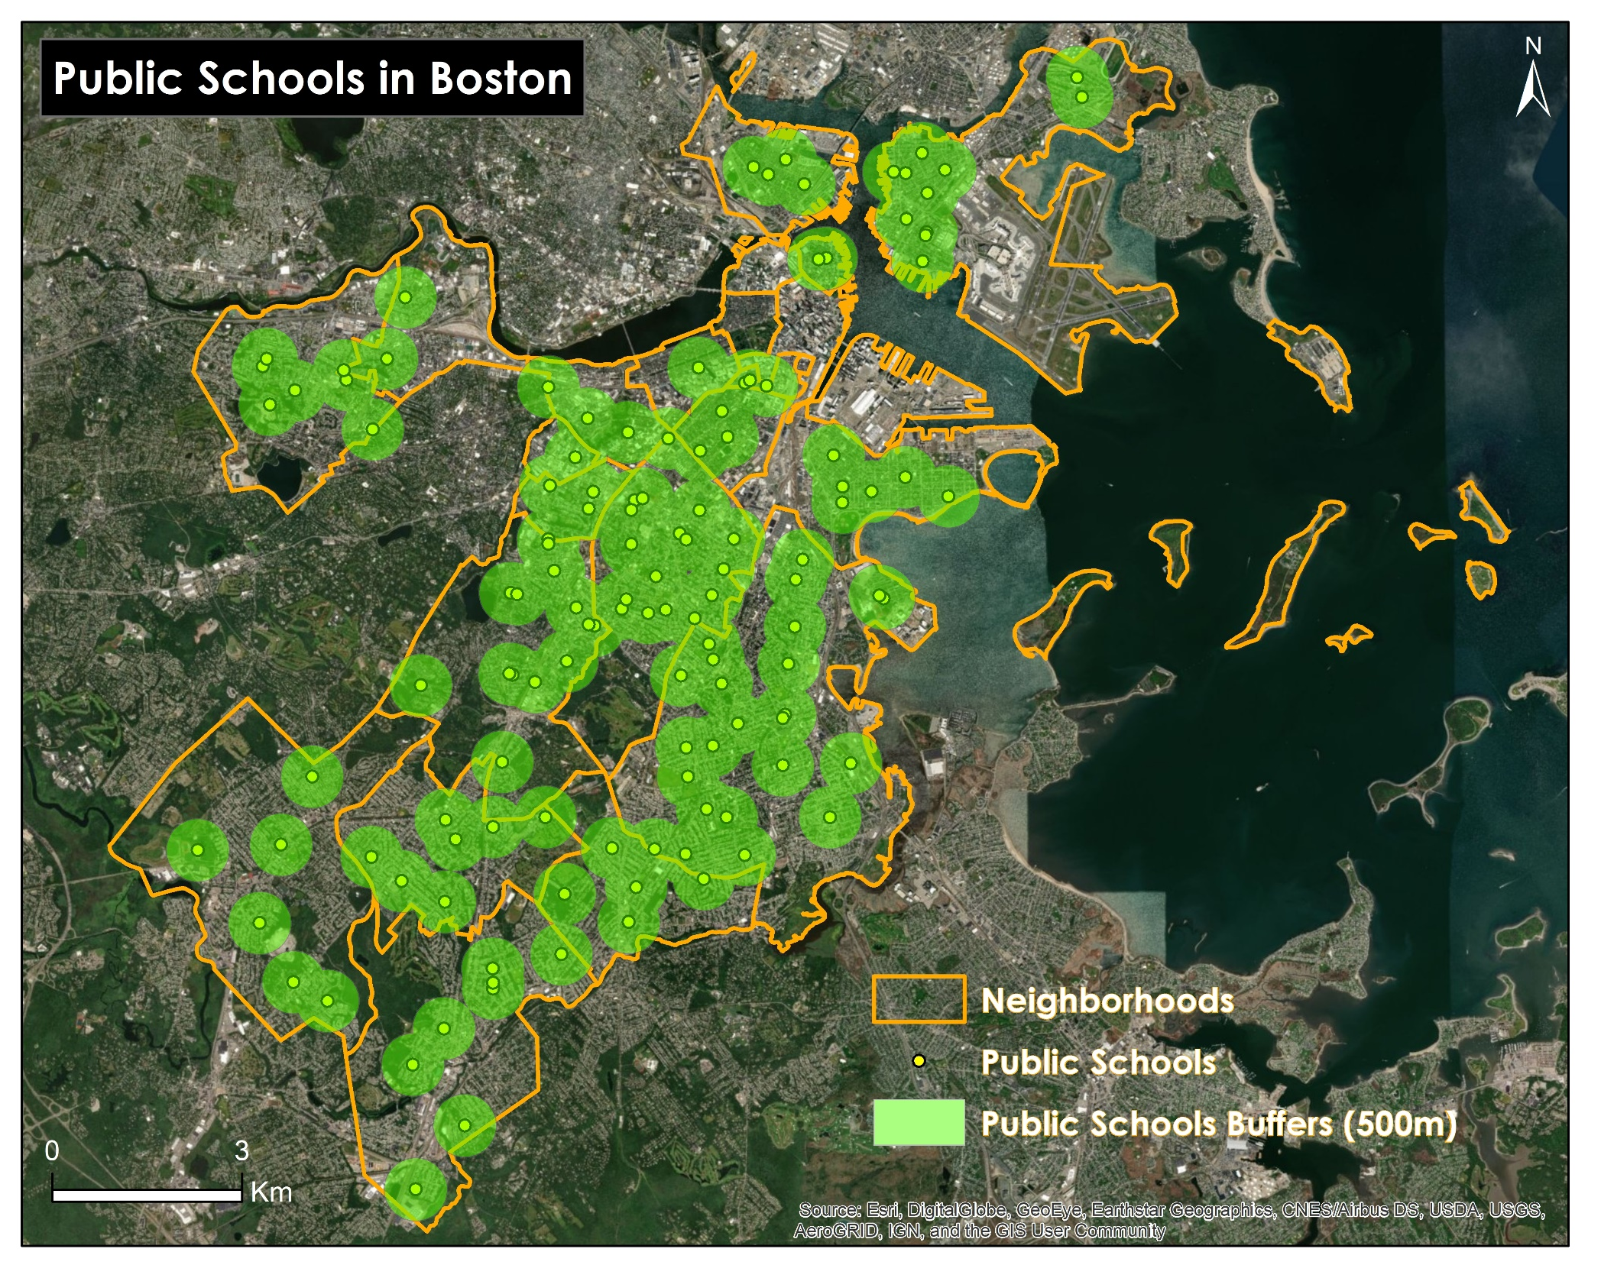

Slide 22
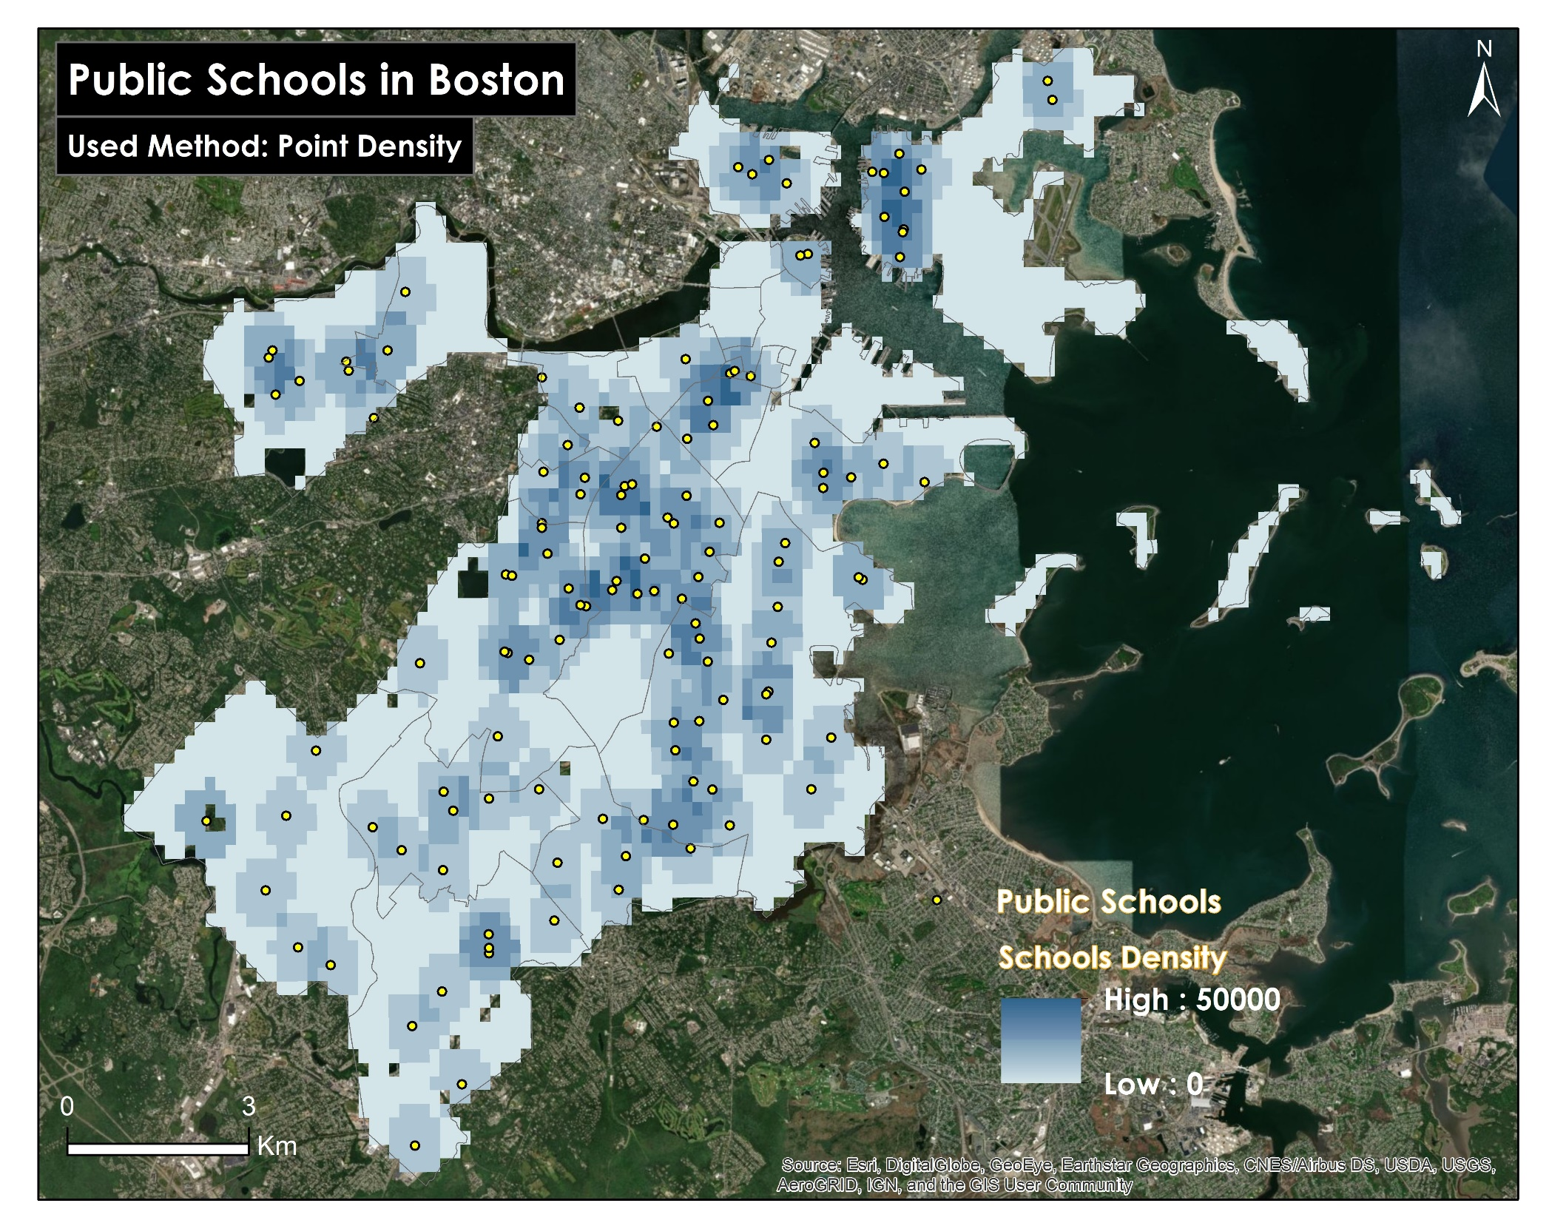

Slide 23
Total population
White population
Black population
Hispanic population
Asian population
Other population

